Slide 1
Broadleaf Management within the Coast Area
By Craig Wickland, RPF
Forest Stewardship Section Head, Coast Area
Chair CRIT Silviculture Working Group
Notes:
Introduce self

Slide 2
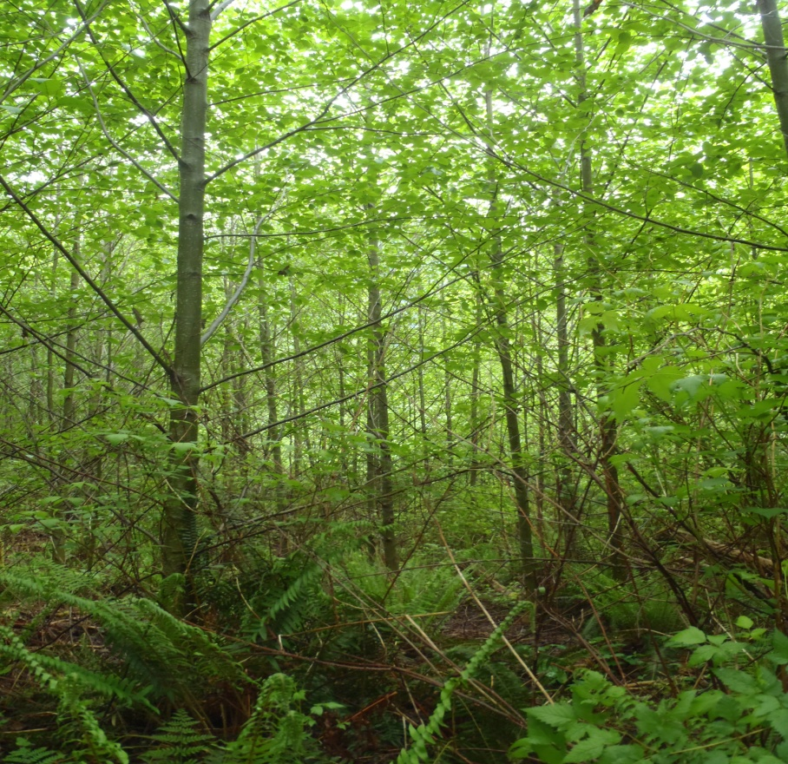
Introduction
Background
Objectives
Strategies
Implementation
Challenges
Recommendations

Slide 3
Background
Broadleaf species on the coast historically regarded as weed species
Major FG issue in many plantations
Markets for alder in the 1980’s and earlier were intermittent and often faded overnight
Markets for alder in the mid 1990’s began to stabilize and prices for sawlogs began to rise
FLs to harvest alder granted in 1996 permitting growing of limited alder under an intensive regime
Coast Forest Action plan developed 2007
Coastal Hardwood Management Strategy published 2008

Slide 4
Coast Forest Action Plan
  October 2007
  Encourages a diversity of species and products across the landscape to adapt to changing economic and environmental conditions (e.g., climate change)
  Recognizes that broadleaf species support a high value market
  Encourages a stronger alder market
  Encourages a strengthened strategy for harvesting and management of alder

Slide 5
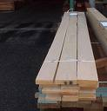
Objectives and Key Principles
Broadleaf timber production and long term forest resilience
Help to address timber supply short falls (medium and long term)
Diversify timber yields and broaden market opportunities
To minimize the regeneration period and costs on sites traditionally recognized as difficult to regenerate conifers
Manage for root disease as a short rotation crop
Broadleaf Management is not intended to:
    Specifically manage for biodiversity
    Promote nutrient cycling
    Provide a nurse crop to grow other species
Notes:
Dr is seen as the species with the greatest potential for Broadleaf production on the coast. There is also potential for management of Mb and Ep.
Focus of Broadleaf management is for the production of sawlogs

Slide 6
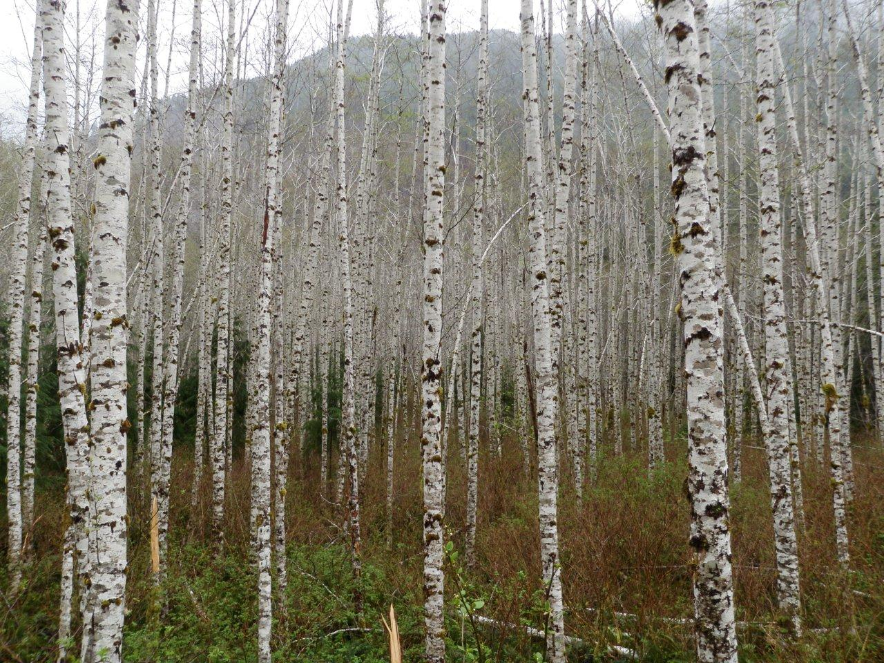
Objectives and Key Principles
Management targets by District:
•Sunshine Coast Resource District – 250 ha per year
•Chilliwack Resource District – 250 ha per year
•Campbell River Resource District – 200 ha per year
•North Island – Central Coast Resource District – 200 ha per year
•South Island Resource District – 100 ha per year
•Other Resource Districts – 100 ha per year
Notes:
As part of the management strategy interim targets by district were developed for Broadleaf management. The objective of the 1200 ha per year interim target is to yield an annual harvest of approximately 300,000 m3 (i.e., enough volume to sustain a medium size mill)

Slide 7
Management Strategies
3 Broadleaf Management regime options:
    Intensive
    Extensive
    Mixed Wood
Notes:
The 2008 Hardwood management strategy developed by CRIT suggested three management regimes for managing broadleaf species

Slide 8
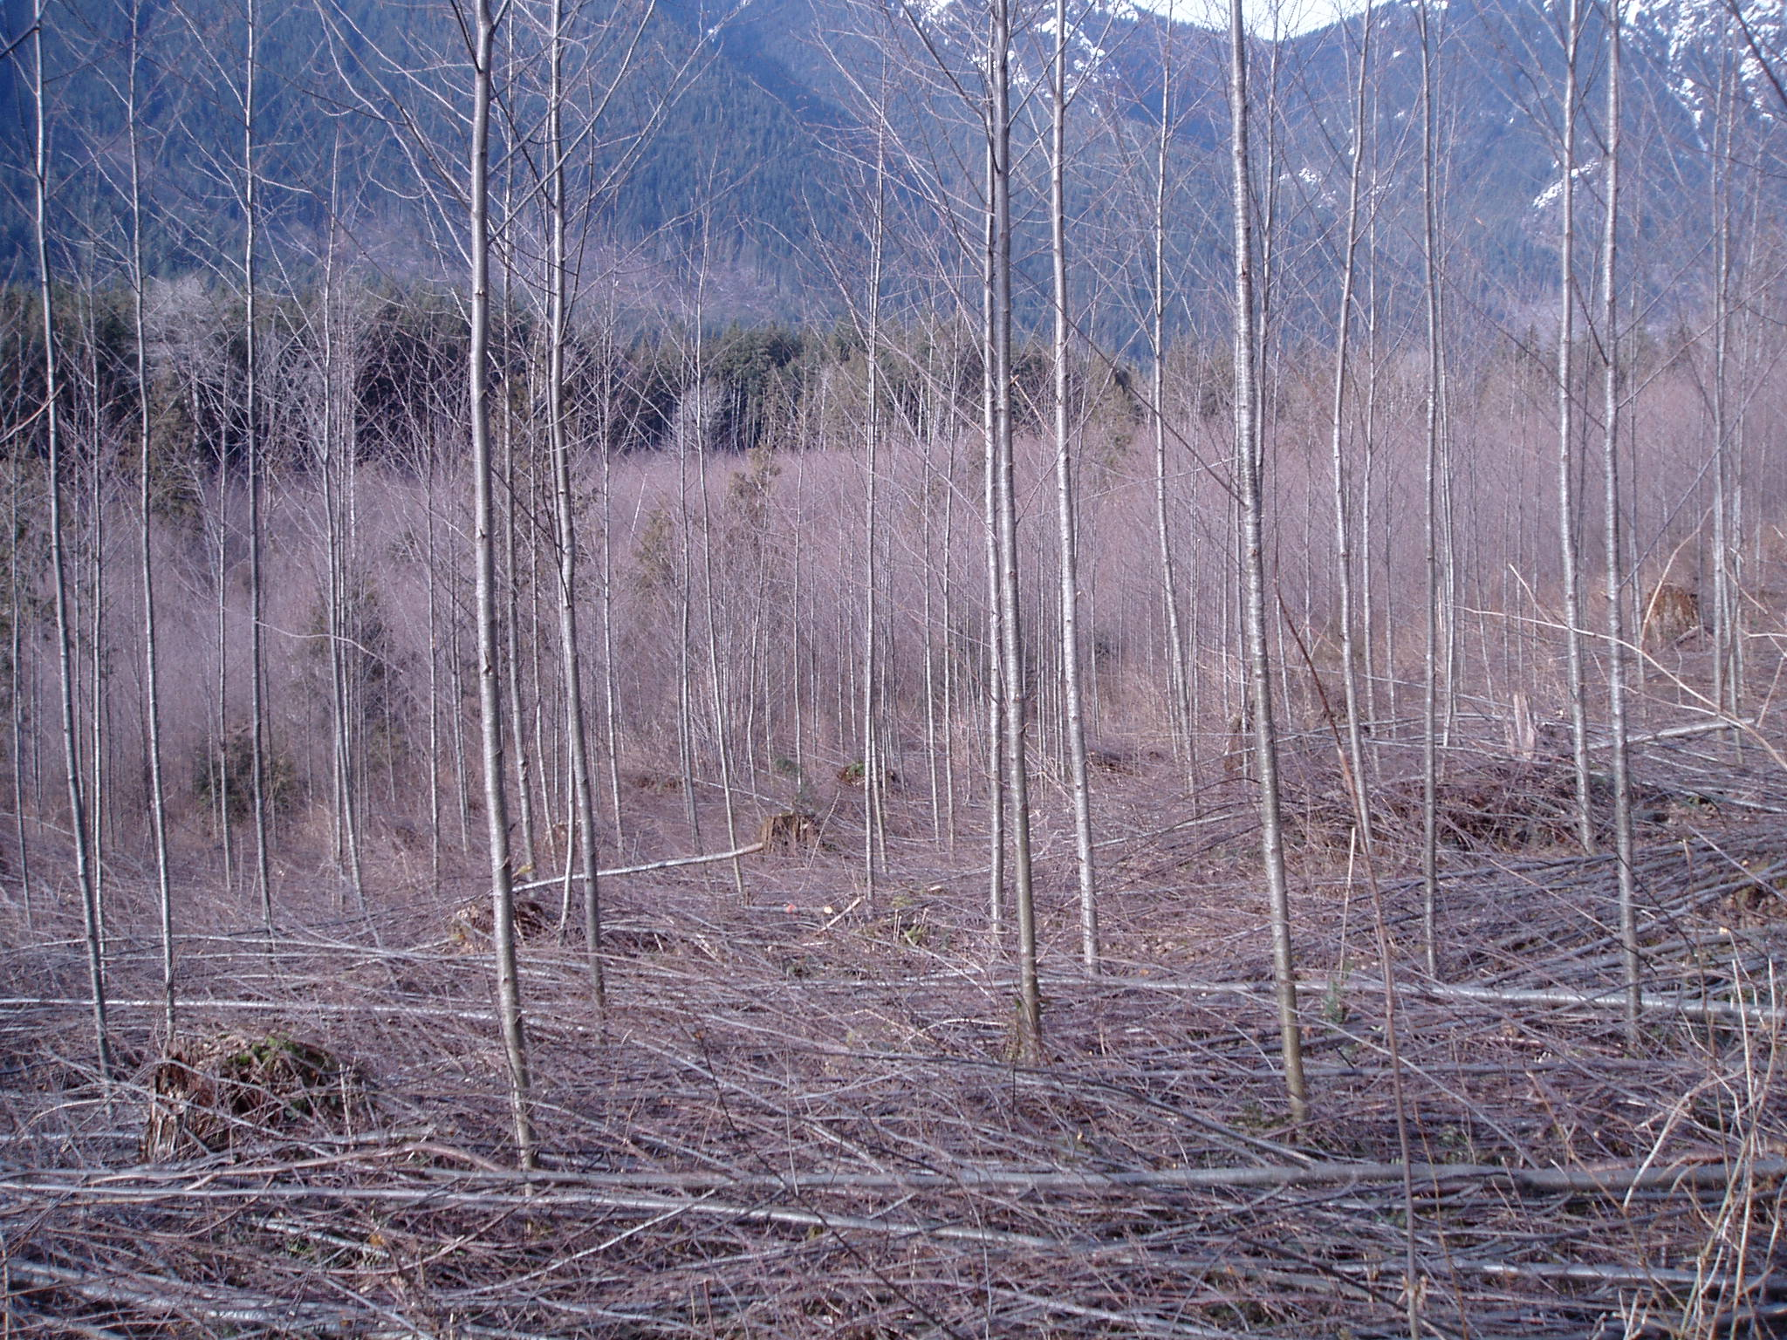
Management Strategies
Intensive management strategy
Notes:
A variety of strategies can be employed across the landscape to achieve timber flow objectives
Produce a sawlog (13 meter log with 20 cm top) in a short rotation – 25-35 years
No reduction in AAC when compared to conifer. Growth rates of Dr exceed those for conifer in first 25 years for example
This strategy needs high initial establishment density, rapid early growth rates, live crown management and control of stocking
Short rotation involves a balance between maintaining growth and advancing the height to live crown ratio to produce a stem bole with smaller and fewer knots
Rotation lengths and harvest timing are management decisions which can be manipulated to meet timber supply needs

Slide 9
Intensive Regime
Site Prep | Stocking density | Stocking Control | Final Harvest (rotation)
Optional herbicide mechanical | Planting 1400-1600 sph Optional Fertilize at time of planting with Phosphate | Stand height 10 m 50 % live crown ratio Post spacing density 600-1000 sph | Target 30 cm dbh Target age 25-35 Target volume 300 m3 per ha
Notes:
Funding for stocking control (spacing) is through Timber Supply Mitigation Investment Category of the Land Based Investment Strategy. Under the strategy stocking control is not considered a basic silviculture obligation.
Stocking control is seen as an incremental treatment as part of a management decision to meet timber supply needs.

Slide 10
Intensive Regime
No impact in AAC
Suitable for filling gaps in timber supply
Requires some certainty for access
Costs for stocking control (spacing) are funded through the Forest for Tomorrow program (FFT) of the Land Based Investment Strategy
High initial density and uniform distribution more important than in a conifer regime – applies to all alder regimes
Notes:
Since 2009 294.4 ha of alder stands have been spaced across the Coast Area (Sunshine coast, Campbell River and North island) under the Forest for Tomorrow Program of the Land Based Investment Strategy, primarily in 2011, 2012 and 2013. 37.1 ha of alder leading stands have been spaced in the North island Central coast district.
Spacing shortens rotation age through acceleration of diameter growth in young alder stands enhancing midterm timber supply and red alder inventory limitations.

Slide 11
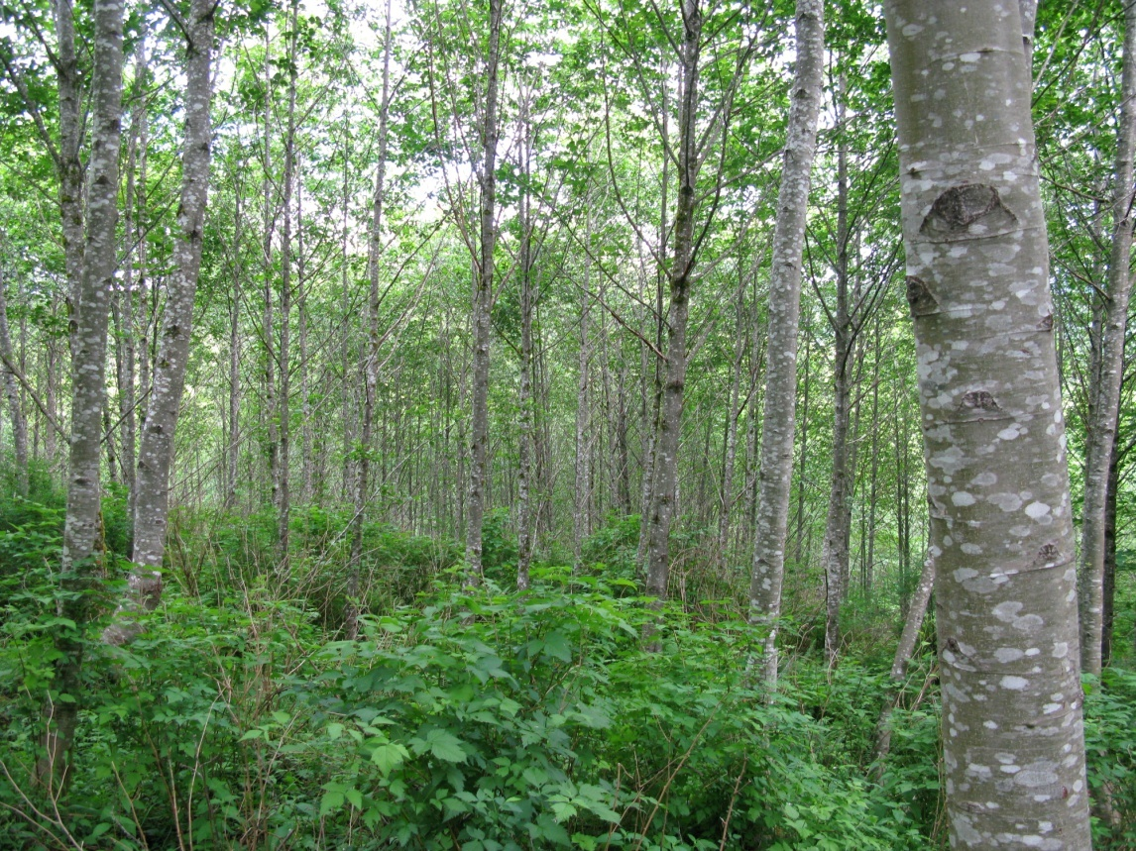
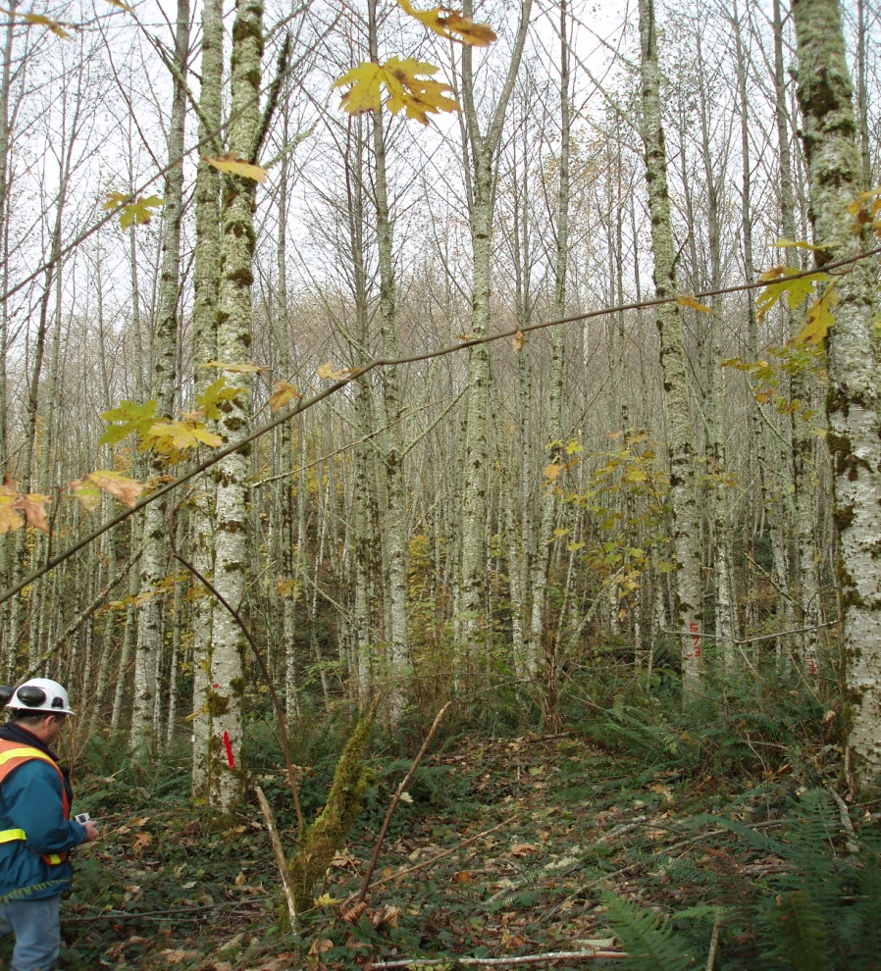
Management Strategies
Extensive management strategy
Notes:
Objective to produce a sawlog with minimum size characteristics in a 30-50 year rotation
Anticipated slight reduction in AAC when compared to conifer management, as MAI for conifers exceeds that for hardwoods after approx age 25. At a broad level however, AAC impact at the management unit level expected to be minimal given the small area targeted for broadleaf management
Fill medium and longer timber supply gaps in locations further from development centers, or areas with more difficult access.
To meet desired product objectives rapid crown closure and suppression of lower branches is still very important. Requires high initial stocking and uniform tree distribution
Too low an initial density may result in crop trees with extensive branching with insufficient clear wood to meet desired product objectives

Slide 12
Extensive Regime
Site Prep | Stocking density | Final Harvest (rotation) | Comments
Optional herbicide mechanical | Planting 1000-1200 sph Optional Fertilize at time of planting with Phosphate | Target 30 cm dbh Target age 30-50 years Target volume 300 m3 per ha | Natural ingress not well understood prompt planting recommended

Slide 13
Extensive Regime
Slight reduction in AAC when compared to conifer management
Potential to fill medium and longer term gaps in timber supply
Suited to more remote locations or locations with restricted access

Slide 14
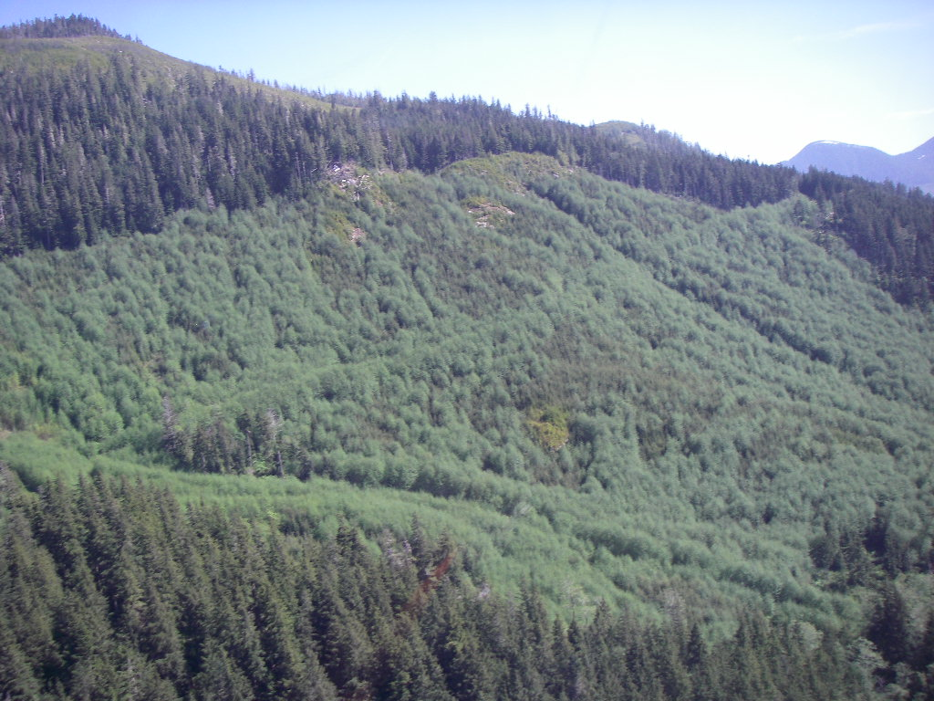
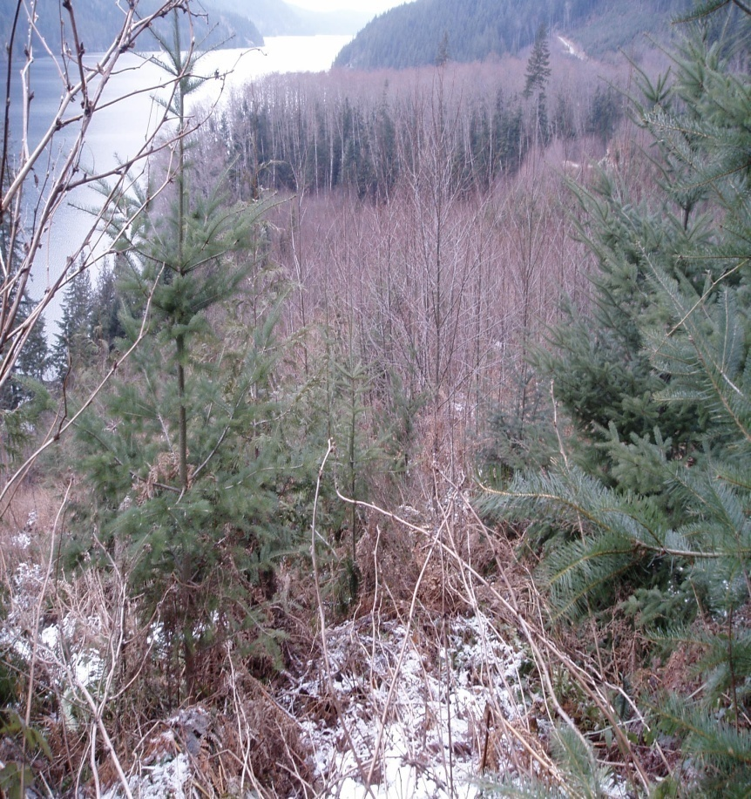
Management strategies
Mixed wood management strategy
Notes:
Under a mixed wood strategy target is to produce both a conifer and a broadleaf saw log in a 50-70 year rotation
Anticipated slight reduction in AAC similar to that of an extensive regime
Mixed wood – divided into land types C (> 80 % basal area) , CD, DC or D
Mixed wood types DC or CD
Stratified mixtures (broadleaf overstory with conifer understory)
Intimate mixtures (both components show dominance on site)
Mosaic mixtures (distinct patches) –stratified in distinct broadleaf and distinct conifer patches
Coast strategy will focus on Mosaic mixtures in small to medium size patches
Minimum patch size 0.5 ha
Focus in on Dr and conifer on similar rotations

Slide 15
Mixedwood Regime
Strategy option | Site Preparation | Stocking density | Final Harvest | Comments
Patch Mixedwood (> 0.5 ha) | Optional - Mechanical | 1000 -1200 sph of conifer 1000-1200 sph of hardwoods usually through natural regeneration | Target age 50-70 years | Criteria: Tree density, distribution, patch size, and appropriate ecological site series
Notes:
Generally this regime will rely on natural regeneration of broadleaf species (mainly Dr).
Allows for licensees to convert portions of conifer plantations with good quality natural broadleaf regeneration to mixed wood stands where certain criteria are met
Within each of the distinct broadleaf patches broadleaves will need to be of sufficient density and tree distribution to meet the desired product objectives (similar to extensive regime). Patch size should be > 0.5 ha.
Broadleaf components must be managed on the appropriate ecosystem in terms of productivity.
Some intervention may be required in the conifer patches to meet the objectives ie brushing where broadleaves are impacting conifers

Slide 16
Mixedwood Regime
Recognizes for the first time that naturally regenerated alder within a conifer plantation may be a good thing
Opportunity for reduction in brushing costs; brushing will not be eliminated, but it will be more focused
Slight reduction to timber supply possible
Opportunity for a variety of strategies/regimes
Expectation is to have conifer and alder forest types on the same block, on similar rotations
Critical to decide early if mixed-wood management is the preferred option
Notes:
Coast strategy is to focus on mosaic mixtures with a minimum patch size 0.5 ha

Slide 17
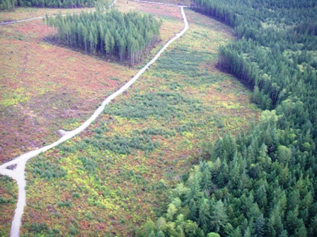
Example of a mixed wood regime
Photo from 2009 CSC presentation by Rick Monchak
Notes:
Small patches of dense Dr (5000 sph plus) within a conifer plantation. An opportunity for mosaic mixed wood management.

Slide 18
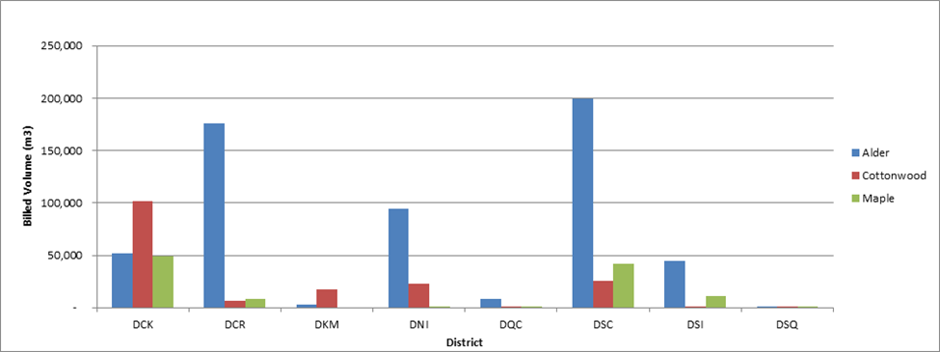
Implementation Results
Broadleaf harvest levels between 2007 and 2013
Notes:
The Coastal strategy has been in place since 2008. In 2014 the CRIT decided to conduct a review of implementation to see how well the Coast had progressed with achievement of objectives and interim management targets. A document entitled “Hardwood Management on the Coast 5 year Review” was developed and distributed earlier this year.
For context the broadleaf harvest level between 2007 and 2013 averaged about 145, 000 m3 per year, which would require approximately 550 ha per year of active management to sustain.
The broadleaf harvest was primarily red alder from the Sunshine Coast, Campbell River, North-island and Chilliwack Resource Districts.

Slide 19
Implementation Results
District | Area in hectares by year
 | 2009 | 2010 | 2011 | 2012 | 2013 | 2014
Campbell River | 1.5 | 10.6 | 3.5 | 122.1 | 77.8 | 90.1
Chilliwack |  |  |  | 102.7 | 41.3
North Island –Central coast |  |  |  | 10 | 62.0 | 58.6
Sunshine Coast | 2.1 |  |  | 11.9 | 38.9 | 91.8
South Island |  |  |  | 6.1 | 17.8
Sea to Sky |  |  |  |  | 3.7
Haida Gwaii
Total | 3.6 | 10.6 | 3.5 | 252.8 | 241.5 | 240.5
Area established through planting since 2009
Notes:
The only broadleaf species planted on the coast between 2009 and 2014 was Dr. The area managed for broadleaf species represents both the intensive and extensive regimes with the average planting density approximately 1300 sph with a range of 1000-1600 sph.
The average standard unit size being managed for broadleaf species was 12.5 in 2012 and 6.9 ha in 2013 but with a range of 0.7 ha to 29.1 ha.

Slide 20
Implementation Results
District | Area in hectares by year
 | 2009 | 2010 | 2011 | 2012 | 2013 | 2014
Campbell River |  | 62.5 |  |  | 3.9
Chilliwack
North Island –Central coast |  | 10.6
Sunshine Coast |  | 5.2 | 29.4 |  | 6
South Island |  |  |  | 5.2
Sea to Sky
Haida Gwaii
Total |  | 78.3 | 29.4 | 5.2 | 9.9
Area established through natural regeneration since 2009
Notes:
A small component of the area established through natural regeneration is for mixed wood management. The area noted for natural regeneration is likely under represented since conversion of conifer stands to broadleaf or mixed wood stands may not yet have been reported into RESULTS

Slide 21
Implementation Results
Amount of area (200-250 ha per year) currently being managed for broadleaf species is significantly less than interim target of 1200 ha per year
To achieve the 1200 ha a year target < 1 % of the area harvested each year on medium to good sites would need to be managed for broadleaf species
Coast Forest Action plan objective of “Encouraging the utilization and management of deciduous species” not likely achieved
Sustainable long term supply of broadleaf species in question
Notes:
Although the trend in broadleaf management has been positive, the 200-250 ha per year currently being actively managed for broadleaf species is less than that required to maintain the average broadleaf harvest over the previous 5 year period, and is not sufficient to increase broadleaf production.
It was expected that there would be little broadleaf management in the first couple of years (seedlings not online).
Based on a RESULTS query approximately 15000 ha a year are harvested across the Coast with 76 % of this area from sites suitable for management of red alder. If we were only to manage for broadleaf species on good site approximately 10 % of the area harvested annually on the coast would need to be managed for broadleaf species to achieve the targets.
If the goal is to build capacity in the Broadleaf manufacturing sector investors will require confidence that there will be a sustainable supply of broadleaf species available for harvest

Slide 22
Challenges / Impediments
  Licensees / professionals lack of specific education and hands on experience with broadleaf management
  Strategic focus of forest companies (i.e., supply softwood fiber to mills)
  Perception that familiar practices (e.g., conifer management) will minimize risk and reforestation costs
  Culture of conifer bias
  Lack of implementation strategy at district level
  Higher site preparation costs on suitable sites with thick forest floors
  Sub-maritime zones more challenging for broadleaf management
Notes:
Operational site plan development in many cases done by forest professionals within the consulting community who may not be aware of the strategic goal for increased broadleaf management and/or adequately trained in broadleaf management. There are different risks and considerations with broadleaf management as compared to conifer management. For example in broadleaf management it is critical to capture the site early and obtain crown closure to maintain stem form. Also for broadleaf species like red alder site selection is critical, since alder needs sufficient moisture during the growing season. Droughty sites, coarse textured soils, and hot south facing slopes are often problematic for ideal growth. Alder is also very susceptible to spring frosts so frost prone sites should be avoided.
For many a paradigm shift is required to manage for broadleaf species as not many years ago the focus was on killing these species to improve growth and survival of conifer crop trees.
Alder is difficult to establish on sites with thick humus. Roots need to get into mineral soil or black and rich organics at the very least
Alder red-stain is associated with cold outflow conditions in many in the coastal valleys in the Sub-maritime seed planning zone.
There is uncertainty regarding reliable seed and planting stock for the sub-maritime seed planning zone.

Slide 23
Recommendations
  Continue to educate licensees/ professionals through workshops, presentations and knowledge transfer
  Incorporate broadleaf management into strategic planning processes
  Encourage the development of local broadleaf management targets through Forest Management Leadership Teams at the district level
  Create a broadleaf seed analysis to determine gaps in seed supply.
Notes:
Strategic planning processes such as type 4 silviculture strategies or the Integrated Resource Management Plan pilot in the Arrowsmith TSA.
Especially important to look at seed supply in the sub-maritime seed planning zones

Slide 24
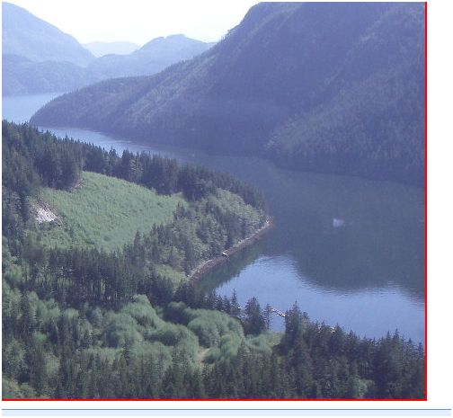
Thank you
Questions?

